Slide 1
Plannit Drexel
Colleen Kovar, Jack Stillwell, Jacob Versaggi

Slide 2
Roles
Client side - Colleen
Fixing scraper - Jack
Retrieving info - Jacob

Slide 3
Our Website
A web page that supplies the user with information in the TMS about courses across colleges and terms.
Most useful for people who are planning on creating a plan of study

Slide 4
Beyond the Client Side
The scraper uses the Term Master Schedule course search
  Using basics of it
  Grabbed all the info we could
Scraper pulls the information
  Server calls the separate modules to grab the information requested
  From the TMS search we could grab any information from the first page
    How page is formatted
  Cheerio

Slide 5
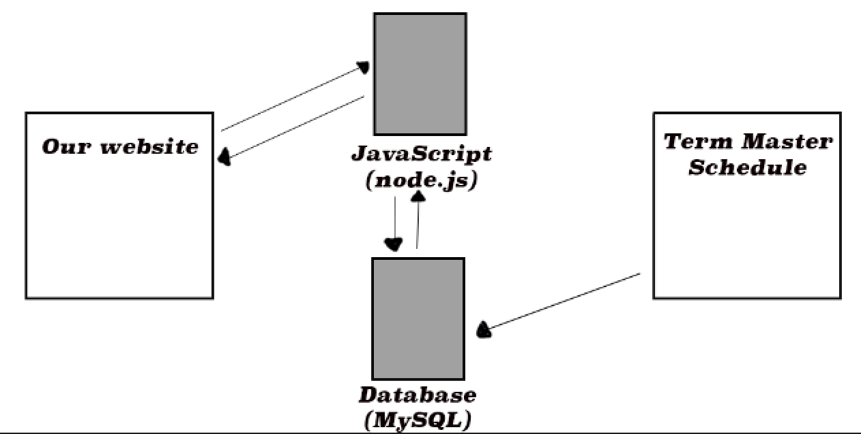
Flow
Scraper

Slide 6
Challenges
Knowing what we were able to get out of the scraper without fixing it
Understanding how the original scraper worked
Telling the scraper to wait before executing
Not being able to meet up as frequently as we wanted
Drexel times out url’s

Slide 7
Lessons Learned
Multiple wat to synchronously call function execution
Drexel’s server doesn’t like people messing with their links
Worked well together as a team

Slide 8
Future Enhancements
Improve database storage
Allow for a more narrow search (checkboxes)

Slide 9
Demo

Slide 10
Questions?

